Slide 1

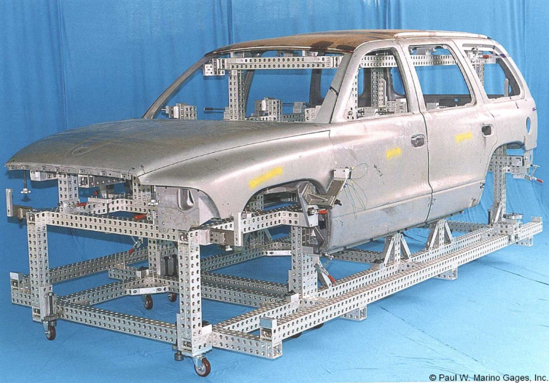
History of Body Cubes
(aka Meisterbock) from Paul W. Marino Gages, Inc.

Slide 2
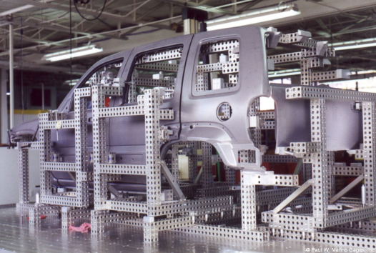
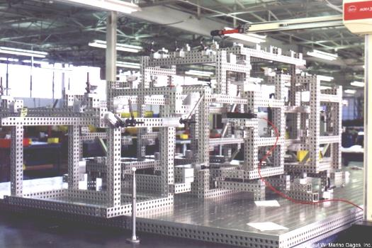
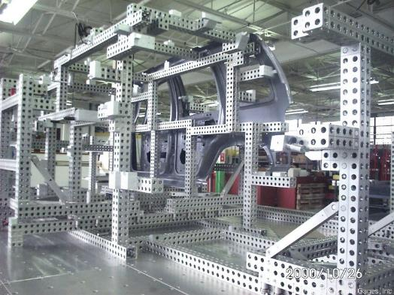
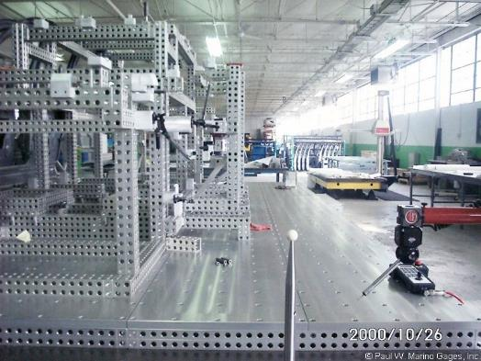
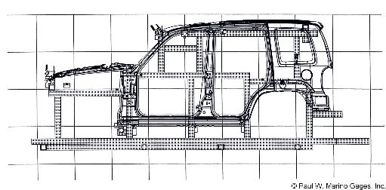
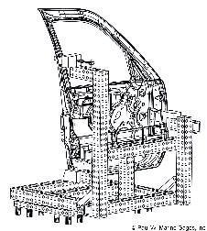
Jeep Liberty SUV

Slide 3
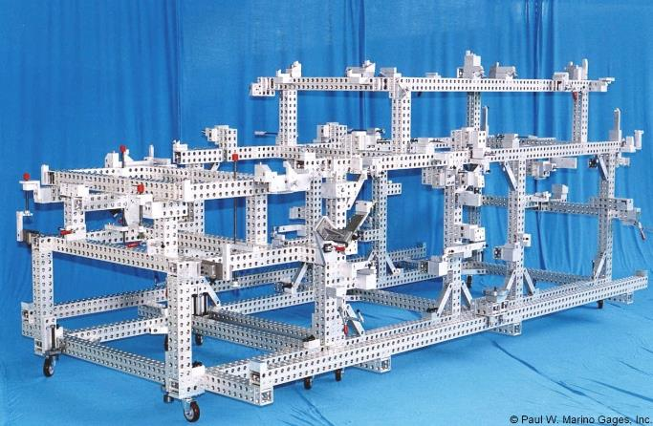
Dodge Durango SUV

Slide 4
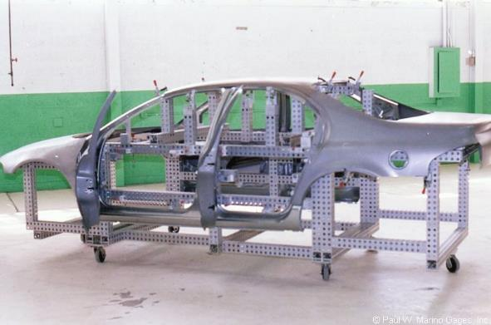
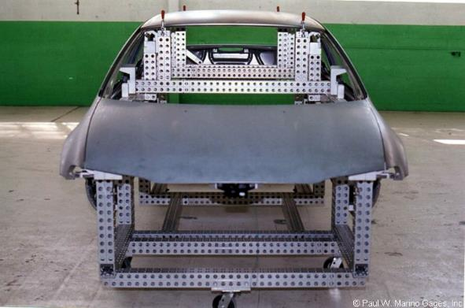
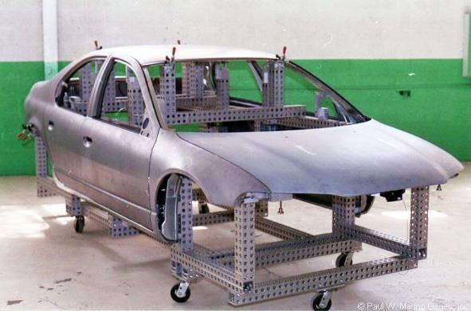
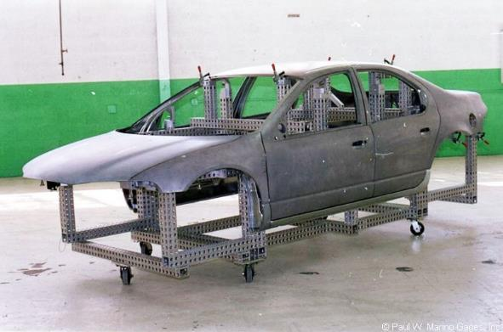
Dodge Cirrus Sedan

Slide 5
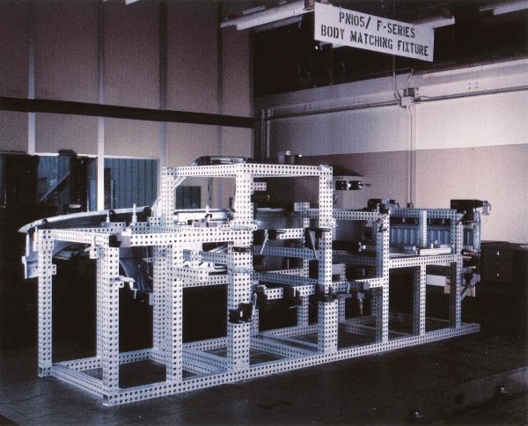
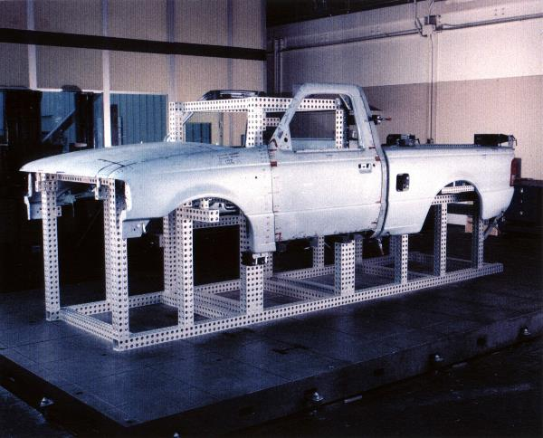
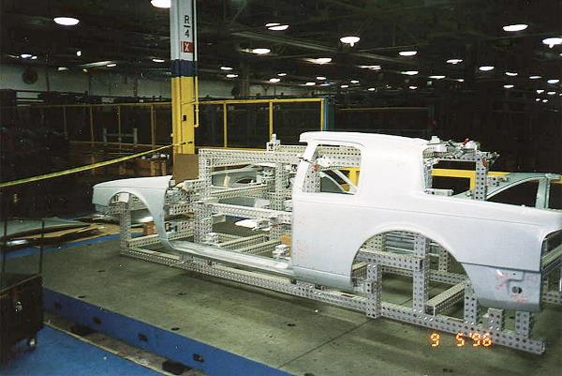
Ford F-150 Pickup Truck

Slide 6
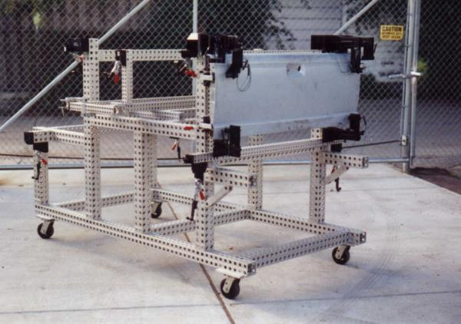
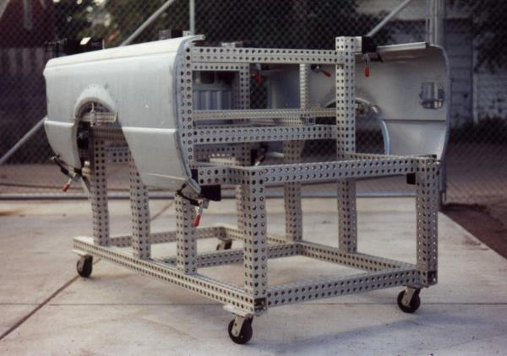
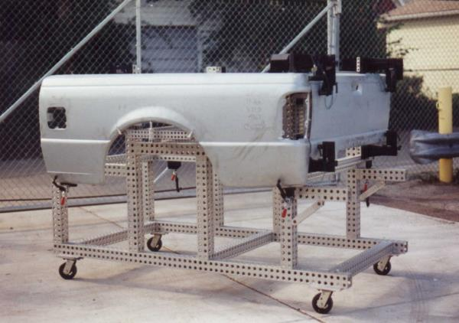
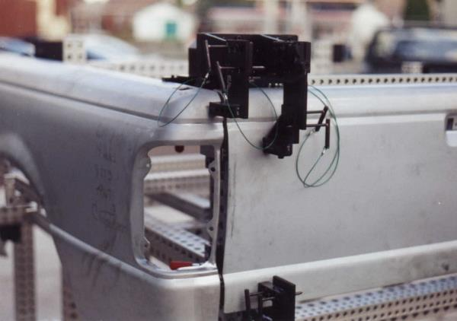
Ford F-150 Pickup Truck

Slide 7
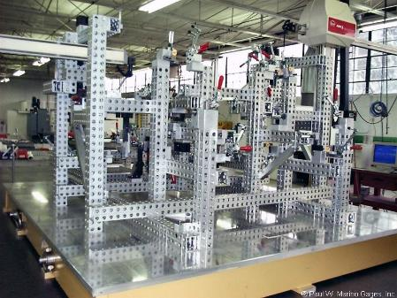
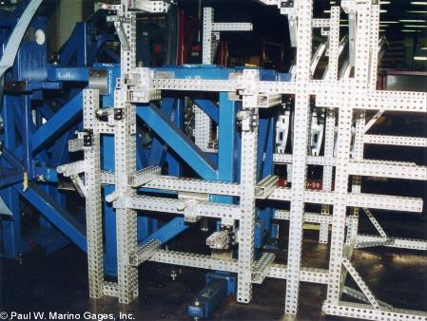

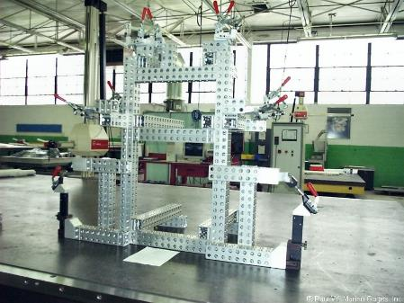
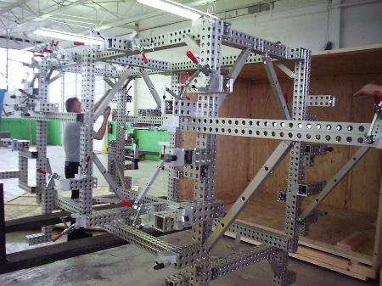
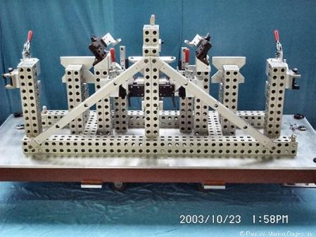
Toyota (above, left), Visioneering (above, middle and right)
Mercedes-Benz (below)

Slide 8
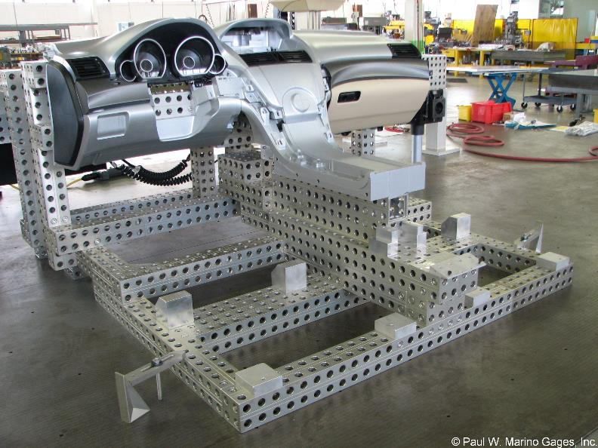
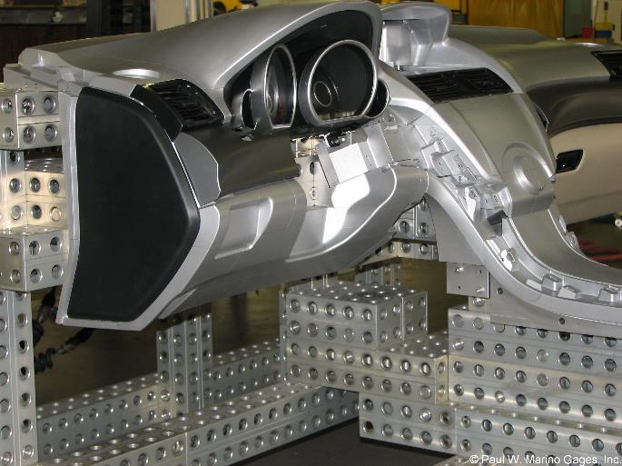
Honda Interior / IP Simulation

Slide 9
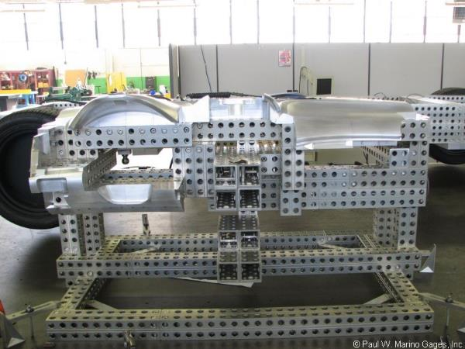
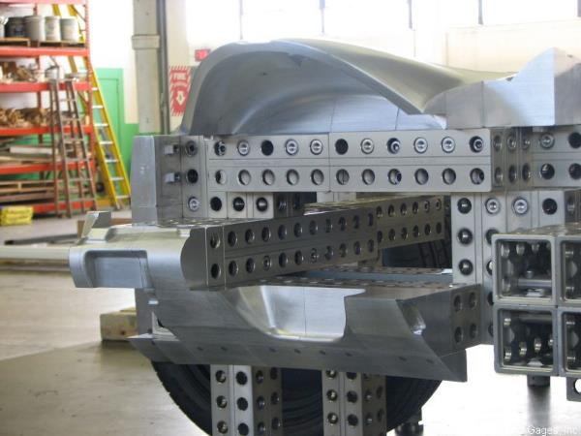
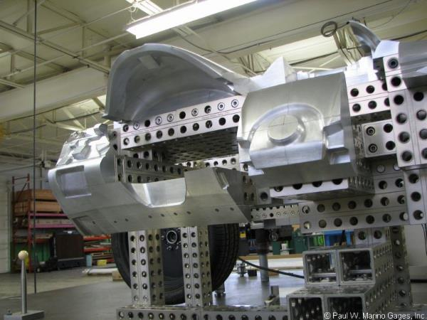
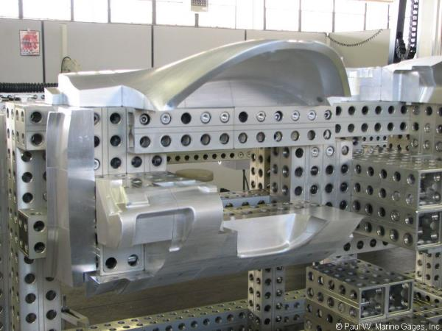
Honda Interior / IP Simulation

Slide 10
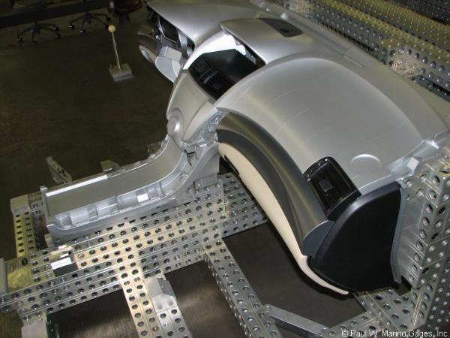
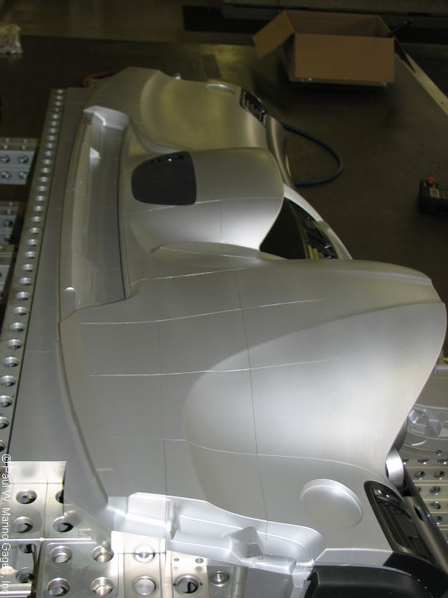
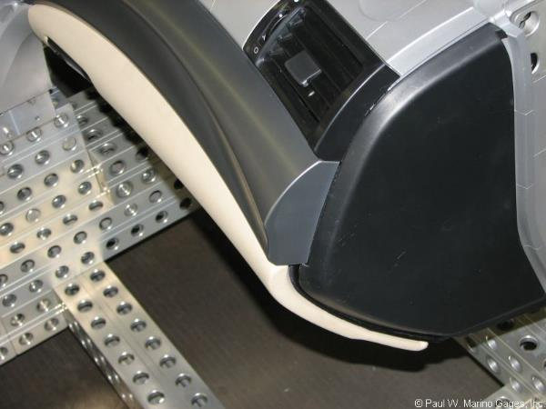
Honda Interior / IP Simulation

Slide 11
Press
American Modular Tooling:
​
Modular Tooling Keeps on Truckin', Quality Magazine, September 2021
Modular Fixturing for Clay Model Making Today, Quality Magazine, March 2020
Fixturing 101: The Sky's the Limit, Quality Magazine, July 2019
Modular Fixturing: How It Works, Quality Magazine, January 2018
Modular Tooling Evolves, Quality Magazine, April 2017
Quality 101: Modular Fixturing Takes Off, Quality Magazine, March 2009
Case Studies: A Modular Fix, Quality Magazine, June 2008
Simplicity Key to CMM Fixturing, Quality Magazine, February 2004
American Modular Tooling Full Line Catalog
American Modular Tooling Studio Tools Catalog
Styli and CMM Accessories:
​
Five Steps to Selecting Styli, Quality Magazine, February 2009
Probes Push CMMs Forward, Quality Magazine, May 2003
CMM Styli and Accessories Full Line Catalog
Measurements and Standards:
​
What is Uncertainty? In Metrology, It's Truly a Deep, Sensitive Subject, Quality Magazine, May 2022
Measurement and Standards Full Line Catalog

Slide 12
If you would like more information about American Modular Tooling or to schedule a demonstration please visit our web sites or contact us with any method below and we’ll be happy to assist you.
American Modular Tooling
Paul W. Marino Gages, Inc. PWM Measurement & Standards, LLC 1 SE Ocean Blvd. Stuart, FL 34994 USA Phone: 313.300.0134
Email: pwminc@pmargage.com Web: pmargage.com / shoppwm.com Linda Goodwin-Marino, President Email: lmarino@pmargage.com
Technical Sales & Consultation Woman Owned Small Business
The contents of this presentation are confidential and are copyrighted by Paul W. Marino Gages, Inc.
AMT and American Modular Tooling are registered trade names of Paul W. Marino Gages, Inc., use by permission only.

