Slide 1
American Modular Tooling Studio Tools

Slide 2
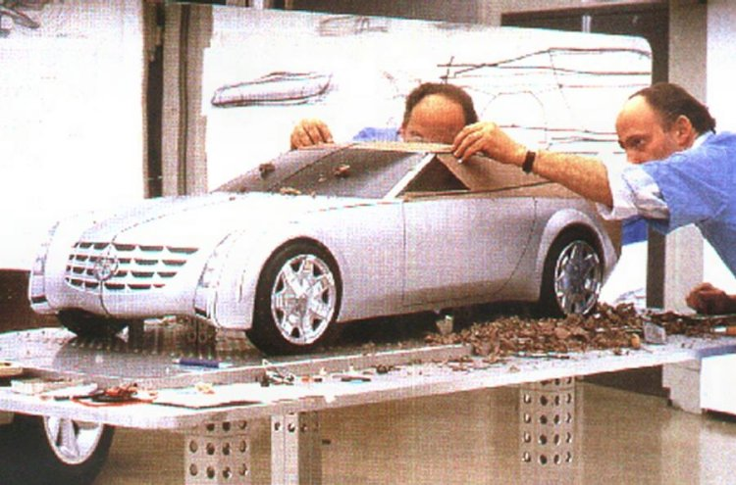
AMT Studio Tables
AMT Studio Tables are available in any size and scale, full or half-model, to your specifications. An optional, adjustable mirror moves away from the model centerline for easy milling and hand sculpting and offers excellent display and preview quality.

Slide 3
Interior Buck
Let us help you design standard armature units for cross-platform use utilizing a common practice approach.

Slide 4
Door Panel Jig
Door Panel Jig
Consisting of:
14524, Door panel jig with door attachment
14517, Door trim jig with functional hardware.
Shown below as part of complete interior buck.

Slide 5
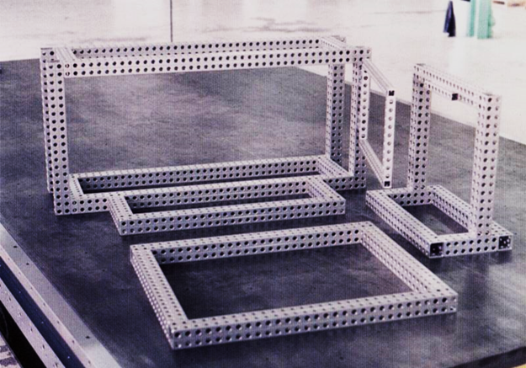
Interior Buck

Slide 6
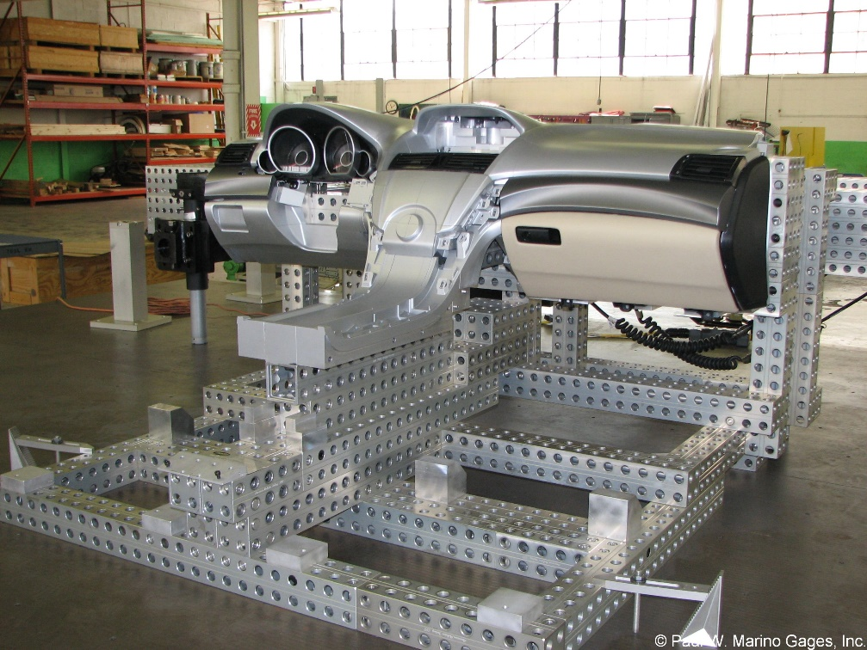
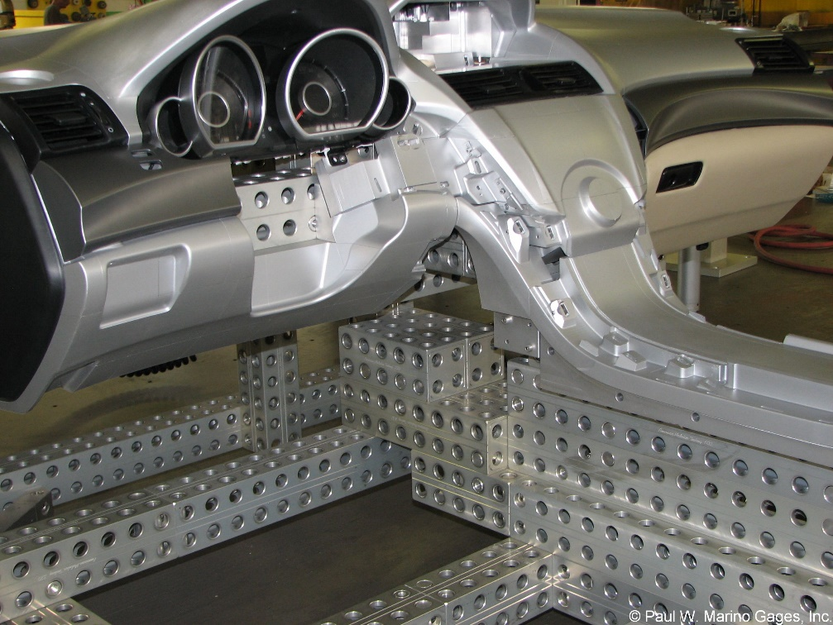
Interior Molded Component Mockup
Honda Civic IP and center console

Slide 7
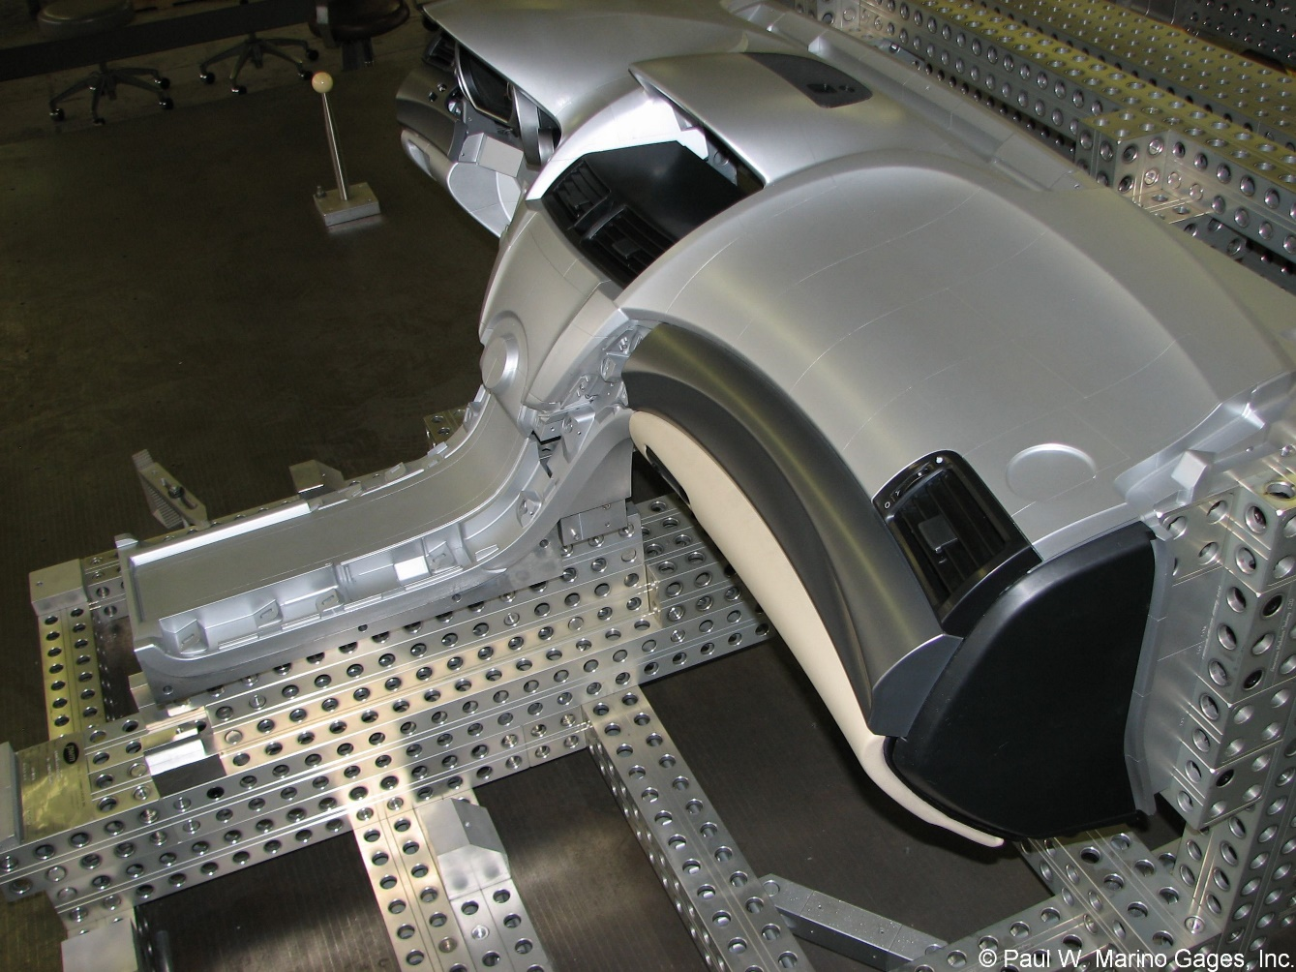
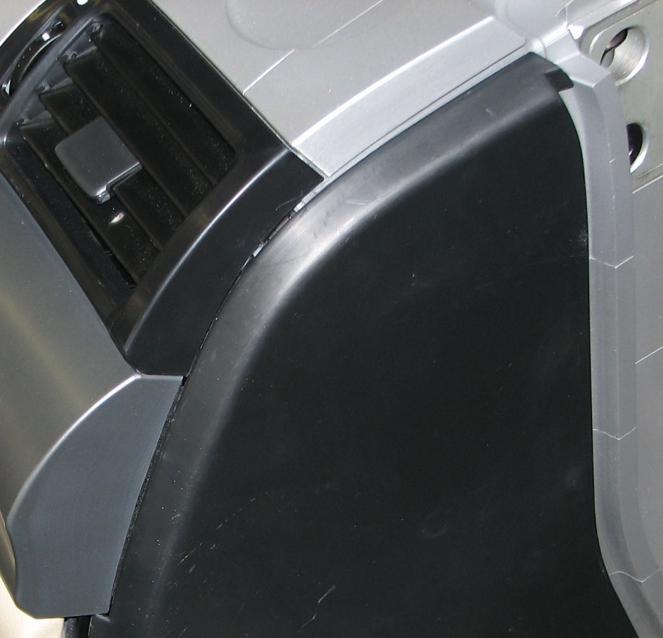
AMT Reconfigurable Custom Nets
Machined surface elements stacked to simulate adjoining molded parts.
Pre-squared nub blocks, removable, reconfigurable for design change, easy access and ROI reusing previous REV.

Slide 8
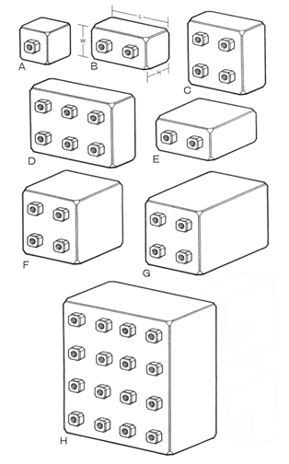
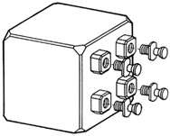
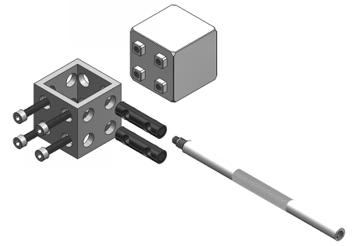
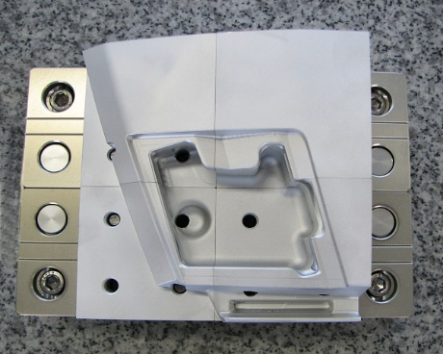
Pre-squared Nub Blocks
Pre-squared blocks for you to machine to your own specifications. 0.03mm /
0.001” accuracy for flatness, perpendicularity and parallelism.
AMT nub blocks can be used for:
Screw & Dowel planes
Pin blocks
Bushing blocks
Pillow blocks
Net blocks
NC free form surfaces
Four nubs shown, above (without/with part)

Slide 9
Studio Tools Accessories
Steering column adapters simulate your column in any position
Universal hinges
Casters
Adjustable foot level
Substrate attachment plate
Pre-squared “Nub” blocks

Slide 10
Special Duty Components
AMT Special Duty Aluminum Hollows combined with Foot Plates and Grid Plates can be used to make extra strong, extra large tools, fixtures and gages. Ideal for assembly work, weld tools and other large work holding jobs.

Slide 11
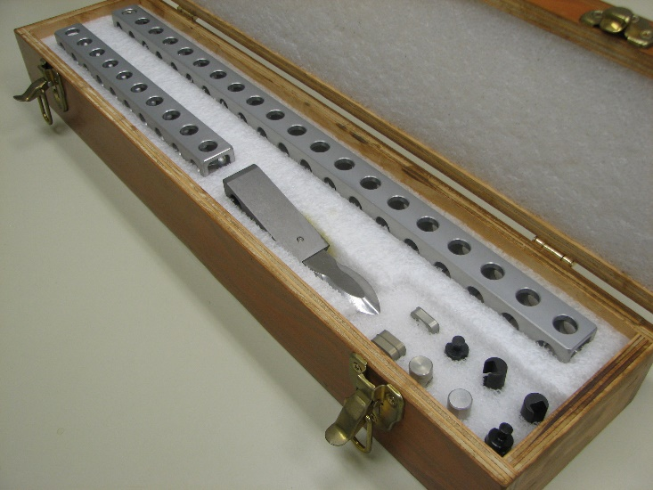
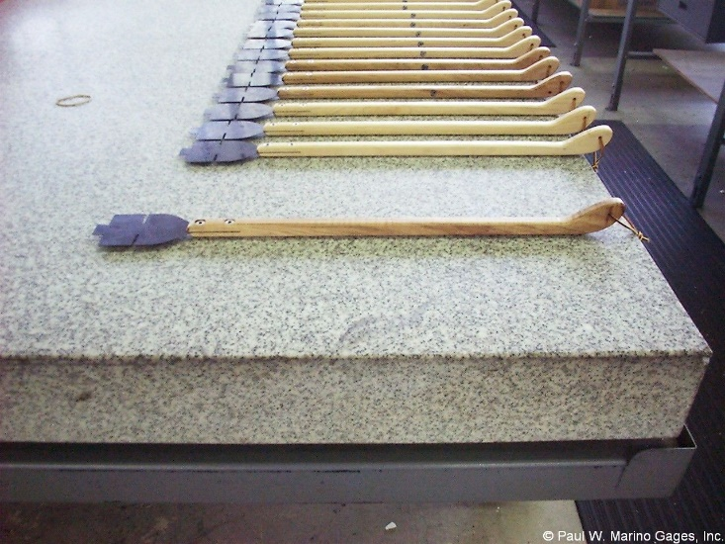
Custom Sculpting Tools
Modular “Mouse” kit (above)
Clay scraping tools (left)

Slide 12
Benefits of the American Modular Tooling System
Manufacturing and Engineering |  |  | Manufacturing and Assembly
❍ Facility Usage | 48% Less |  | ❍ Assembly Labor | 70% Less
❍ Lead Time | 60% Less |  | ❍ Through-put Increase | 45% More
❍ Tooling Costs | 44% Less |  | ❍ Accuracy of Assemblies | 50% Greater
❍ Tooling Labor | 60% Less |  | ❍ Periodic Inspection | 50% Less
❍ Tooling Design Cost | 50% Less |  | Reconfigurable | Priceless
❍ Equipment Needs | 70% Less |  | Modularity | Priceless
❍ Reusable Material | 70% Reusable |  | ❍ Rapid Engineering Changes | Priceless
Other Benefits
❍ Fewer corrosion problems due to hard coat aluminum |  |  | ❍ Can be used as temporary rate tool
❍ Lower shipping costs due to lighter weight |  |  | ❍ Less space required for storage
❍ Faster setup at customer facility |  |  | ❍ Minimal maintenance requirements
❍ Good ROI on leasing tool (70% reusable) |  |  | ❍ Environmentally correct

Slide 13
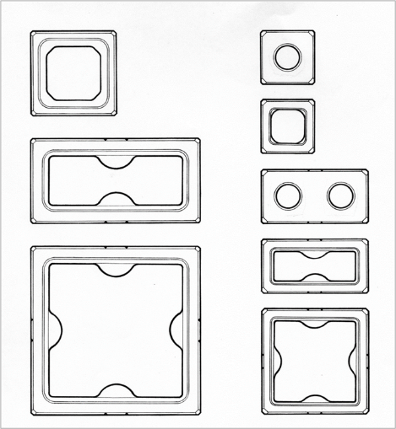
Material Properties of AMT Components
AMT “Professional Grade” Extruded Profiles and Locators |  | AMT “Commercial Grade” Extruded Profiles and Locators |  | AMT Locator and connection Elements
❍ 7075-T6, Temper 6 |  | ❍ 6061-T6, Temper 6 |  | ❍ 2024-T6
❍ KSI Tensile: 78,000 PSI |  | ❍ KSI Tensile: 47,000 PSI |  | ❍ KSI Tensile: 69,000 PSI
❍ KSI Yield: 68,000 PSI |  | ❍ KSI Yield: 40,000 PSI |  | ❍ KSI Yield: 57,000 PSI
❍ Hard Coat Anodized |  | ❍ Hard Coat Anodized |  | ❍ Hard Coat Anodized
❍ Elongation Factor: 6% |  | ❍ Elongation Factor: 8% |  | ❍ Elongation Factor: 10%
AMT “Special Duty” Extruded Profiles |  | AMT “Special Duty” Cast Products
❍ 6082-T6, Temper 6, Special Blend |  | ❍ 319, 0-T5 Sand Cast
❍ KSI Tensile: 45,000 PSI |  | ❍ KSI Tensile: 30,000 PSI
❍ KSI Yield: 30,000 PSI |  | ❍ KSI Yield: 26,000 PSI
❍ Hard Coat Anodized |  | ❍ Hard Coat Anodized
❍ Elongation Factor: 4.5 - 5.5% |  | ❍ Elongation Factor: 1.5%

Slide 14
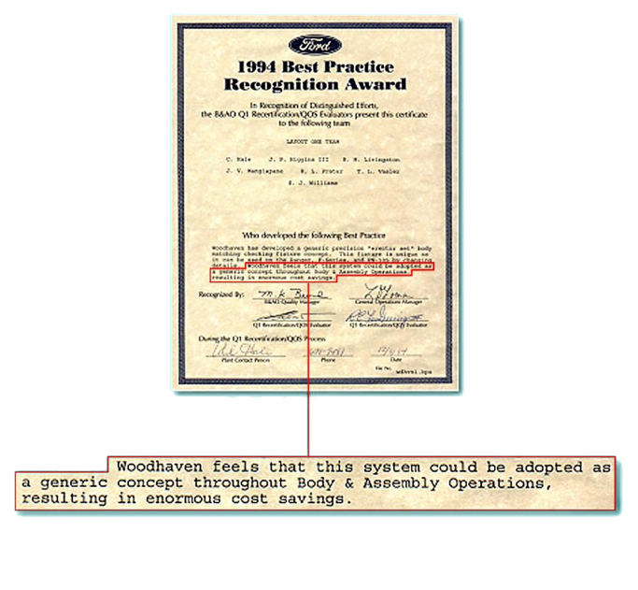
Awards & Recognition
Ford Best Practice Recognition (above)
Chrysler SCORE Award (below)
GM letter of recognition (above)
Dept of Defense MacTech Award (below)

Slide 15
Press
American Modular Tooling:
​
Modular Tooling Keeps on Truckin', Quality Magazine, September 2021
Modular Fixturing for Clay Model Making Today, Quality Magazine, March 2020
Fixturing 101: The Sky's the Limit, Quality Magazine, July 2019
Modular Fixturing: How It Works, Quality Magazine, January 2018
Modular Tooling Evolves, Quality Magazine, April 2017
Quality 101: Modular Fixturing Takes Off, Quality Magazine, March 2009
Case Studies: A Modular Fix, Quality Magazine, June 2008
Simplicity Key to CMM Fixturing, Quality Magazine, February 2004
American Modular Tooling Full Line Catalog
American Modular Tooling Studio Tools Catalog
Styli and CMM Accessories:
​
Five Steps to Selecting Styli, Quality Magazine, February 2009
Probes Push CMMs Forward, Quality Magazine, May 2003
CMM Styli and Accessories Full Line Catalog
Measurements and Standards:
​
What is Uncertainty? In Metrology, It's Truly a Deep, Sensitive Subject, Quality Magazine, May 2022
Measurement and Standards Full Line Catalog

Slide 16
If you would like more information about American Modular Tooling or to schedule a demonstration please visit our web sites or contact us with any method below and we’ll be happy to assist you.
 | American Modular Tooling
 | Paul Marino Gages, LLC. PWM Measurements & Standards 1 SE Ocean Blvd. Stuart, FL 34994 USA Phone: 313.300.0134
 | Email: pwminc@pmargage.com Web: pmargage.com / shoppwm.com Linda Goodwin-Marino, President Email: lmarino@pmargage.com
 | Technical Sales & Consultation Woman Owned Small Business
AmericanModularTooling.com
The contents of this presentation are confidential and are copyrighted by Paul W. Marino Gages, Inc. AMT and American Modular Tooling are registered trade names of Paul W. Marino Gages, Inc., use by permission only.

