Slide 1
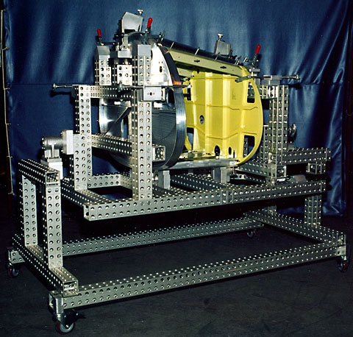
Aerospace Applications

Slide 2
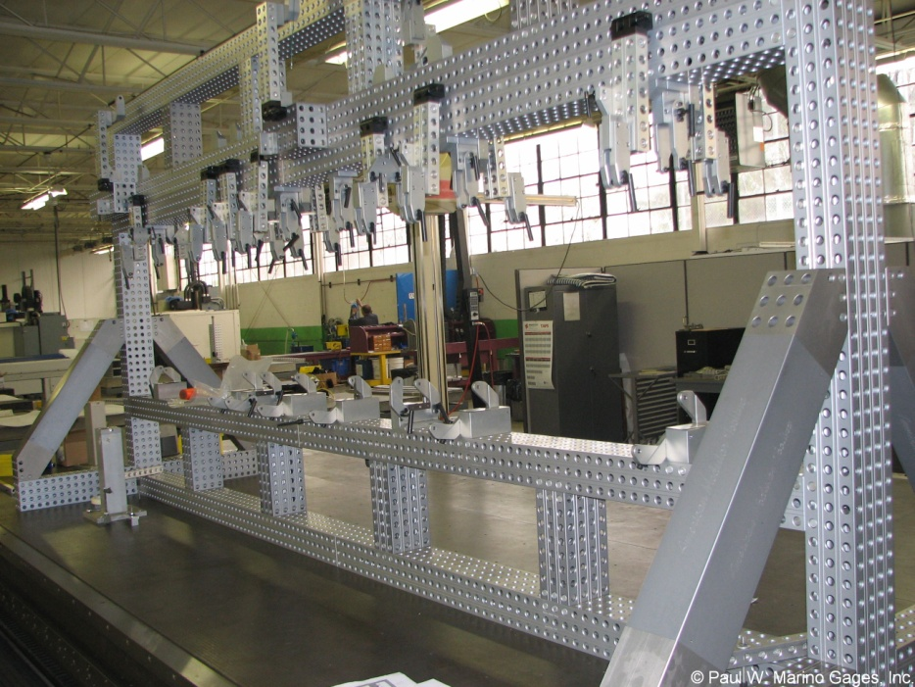
What is American Modular Tooling?
AMT is a completely reusable modular fixturing system for work holding that provides a stable and accurate grid in all three dimensions.
It is ideal for:
Holding Fixtures
Checking Fixtures
Welding Fixtures
CMM Holding Fixtures
Evaluation Cubes
EQAF
Stacks
Build Ups
Modeling Armatures
Gages
Jigs
and more
Bomb bay door tool for Tinker AFB

Slide 3
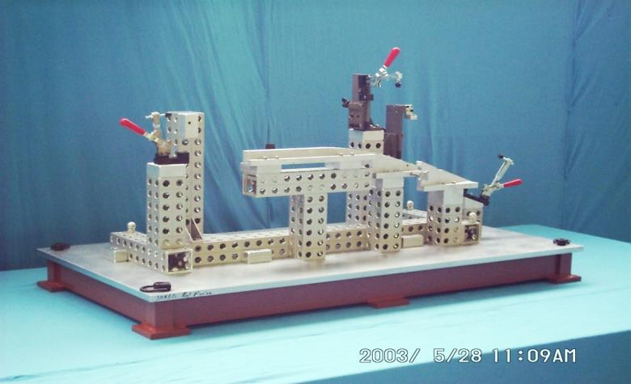
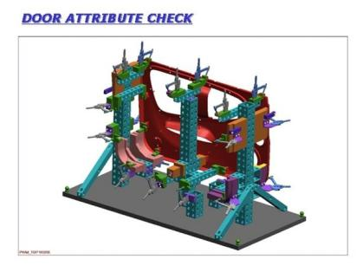
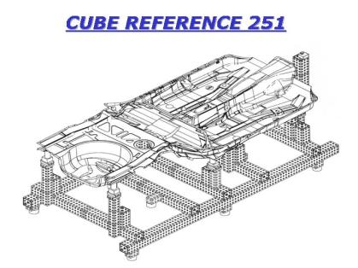
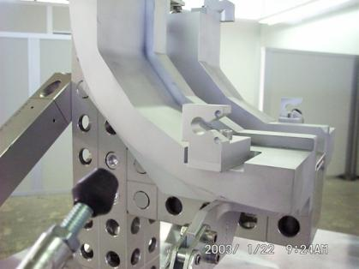
Our expertise originated with Automotive Manufacturing Companies
Some materials shown in photos are not sold by C2 Gauge & Fixture

Slide 4
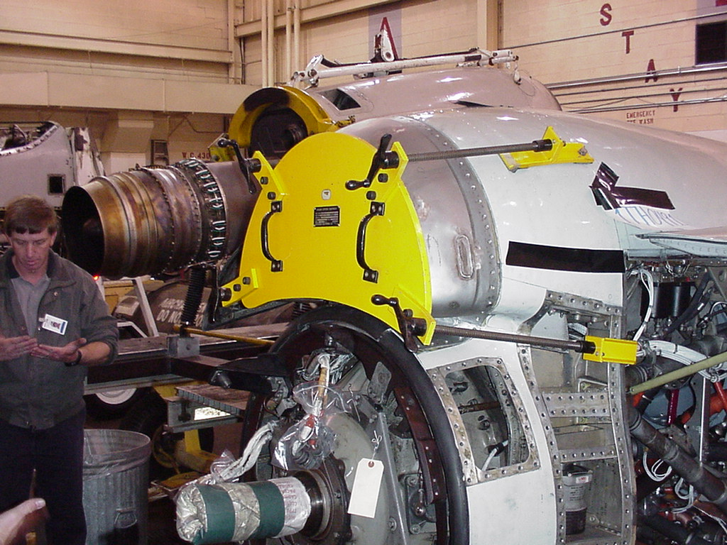
10 Years of Experience with Automotive Applications led to Aerospace Opportunities

Slide 5
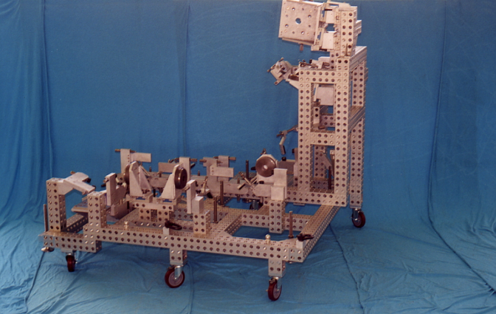
Fuel Line Welding Fixture for Boeing Rocket Engine
Some materials shown in photos are not sold by C2 Gauge & Fixture

Slide 6
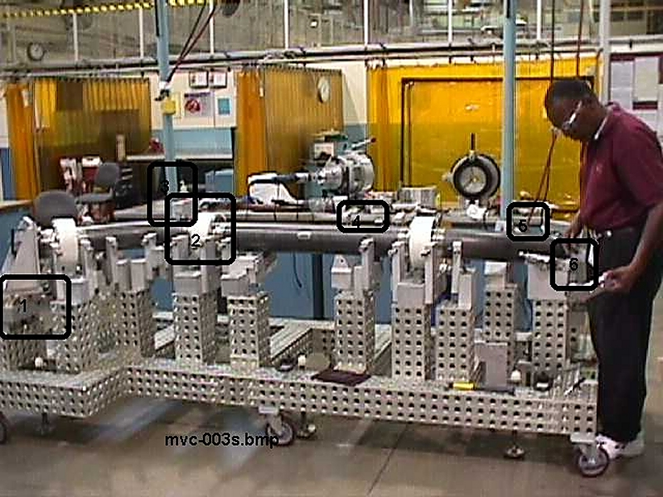
Main Lox Duct, Expendable Launch Vehicle
Some materials shown in photos are not sold by C2 Gauge & Fixture

Slide 7
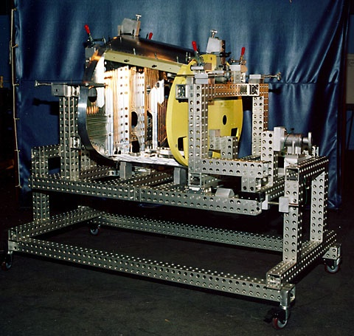
E-Bay Trunion Tool
Some materials shown in photos are not sold by C2 Gauge & Fixture

Slide 9
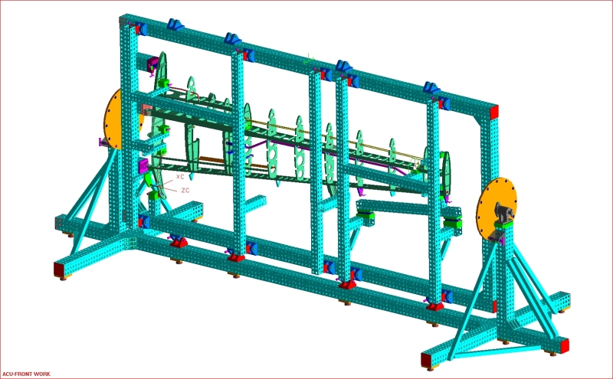
Some materials shown in photos are not sold by C2 Gauge & Fixture

Slide 10
Some materials shown in photos are not sold by C2 Gauge & Fixture

Slide 11
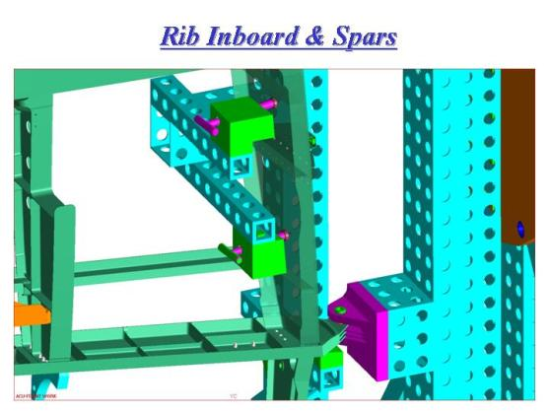
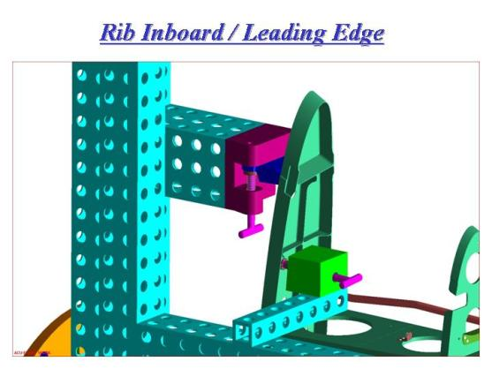
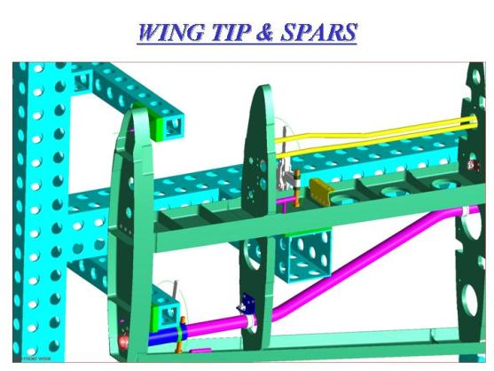
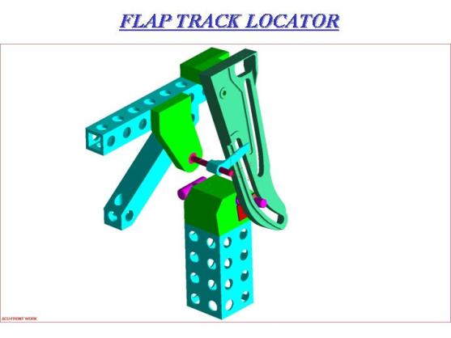
Some materials shown in photos are not sold by C2 Gauge & Fixture

Slide 12
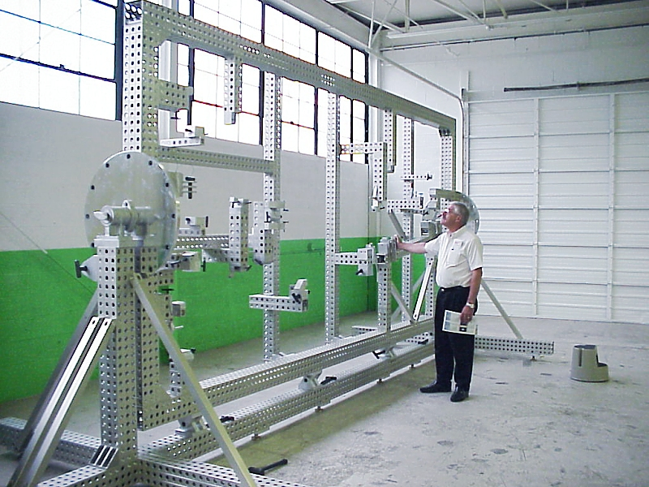
Some materials shown in photos are not sold by C2 Gauge & Fixture

Slide 13
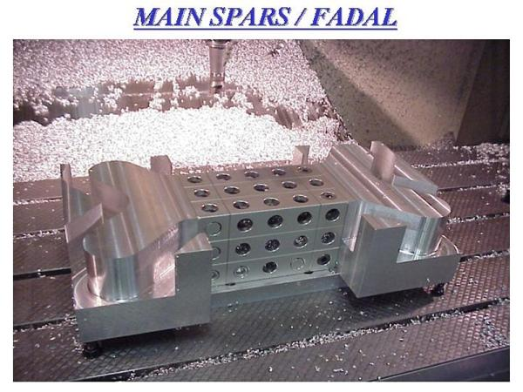
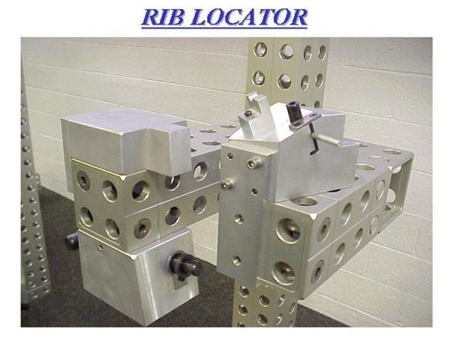
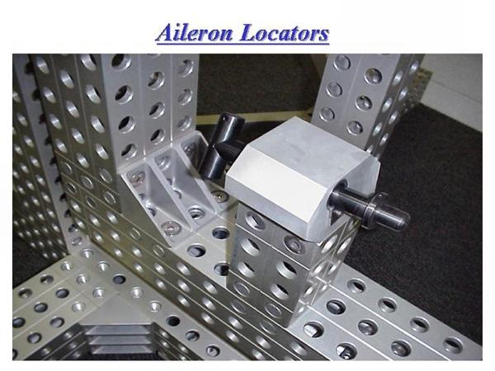
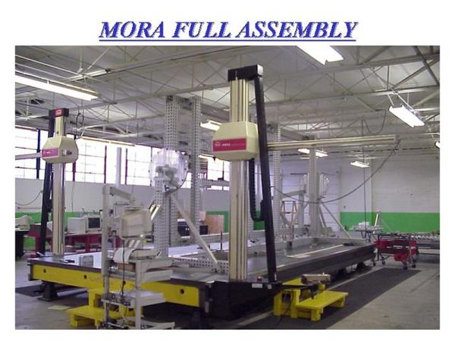
Some materials shown in photos are not sold by C2 Gauge & Fixture

Slide 14
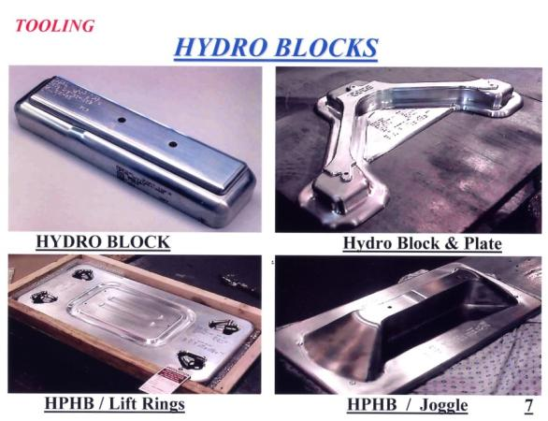

Slide 15
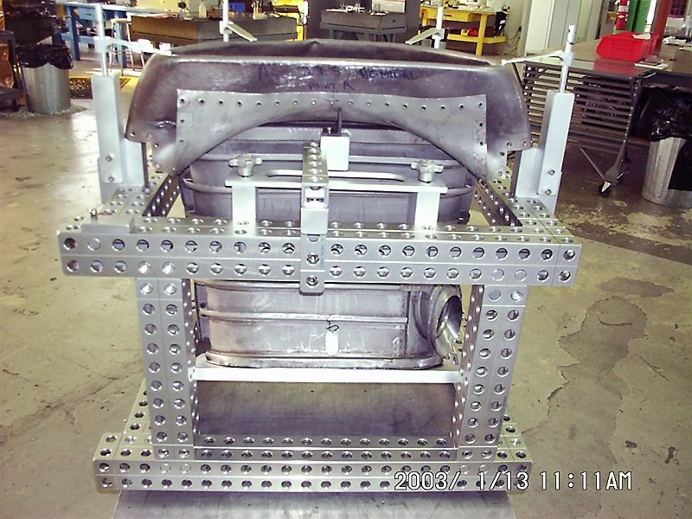
Some materials shown in photos are not sold by C2 Gauge & Fixture

Slide 16
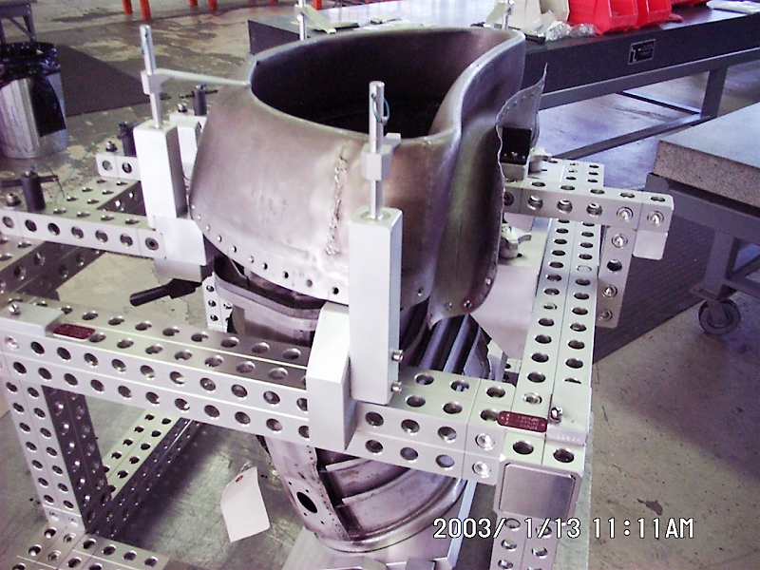
Some materials shown in photos are not sold by C2 Gauge & Fixture

Slide 17
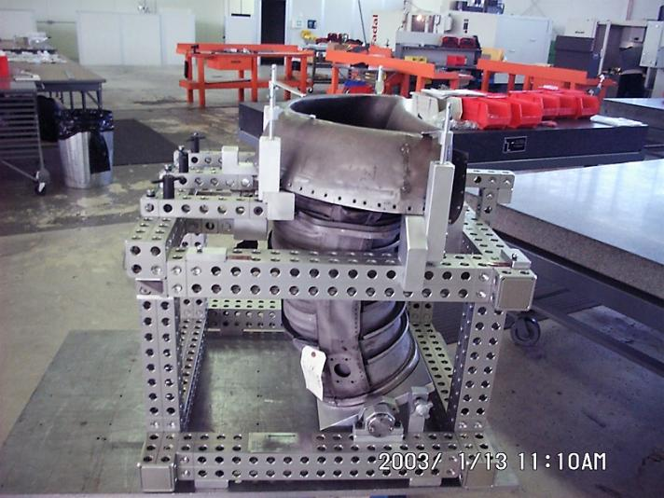
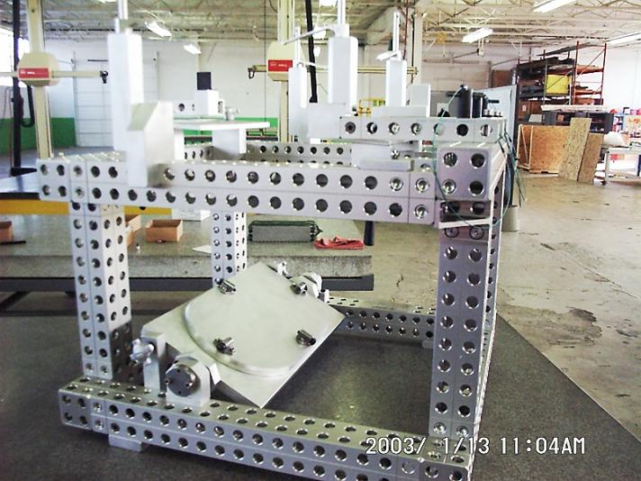
Some materials shown in photos are not sold by C2 Gauge & Fixture

Slide 18
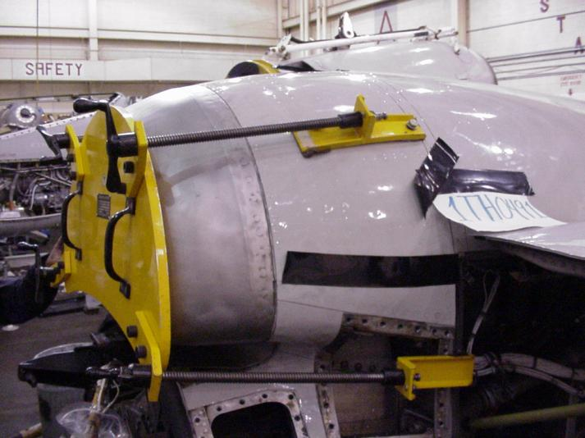
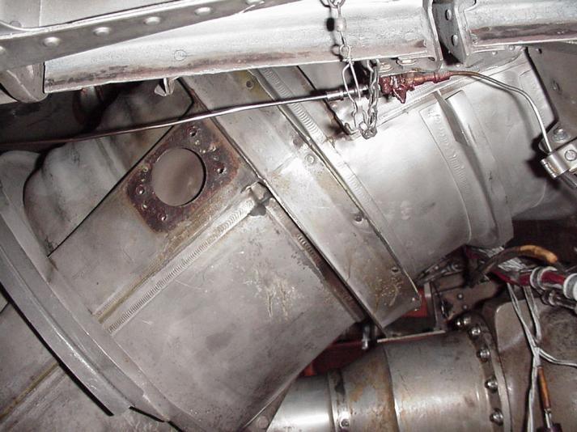

Slide 19
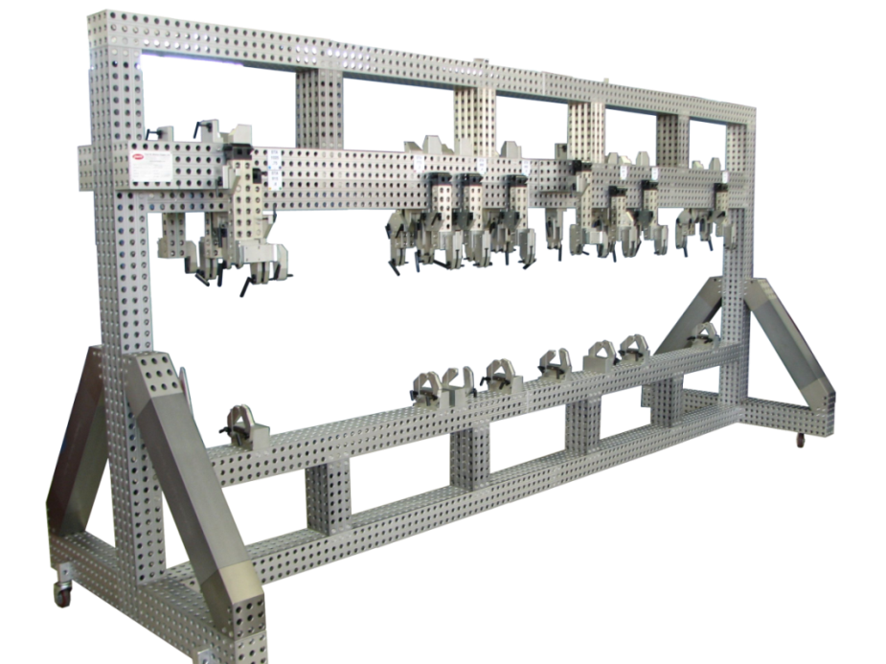
United States of America Air Force (USAF), 2008
Bomb Bay Doors for B52, 1 right/1 left, 1 upper/1 lower, two tools, in 4 parts: AMT Special Duty 120 x 160 Hollows.
Tool is 4,400mm long x 2,400mm high.
Some materials shown in photos are not sold by C2 Gauge & Fixture

Slide 20
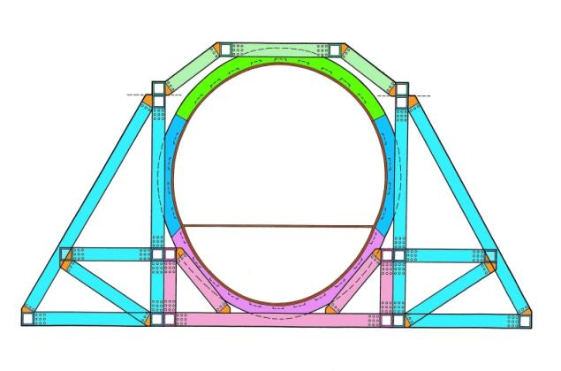
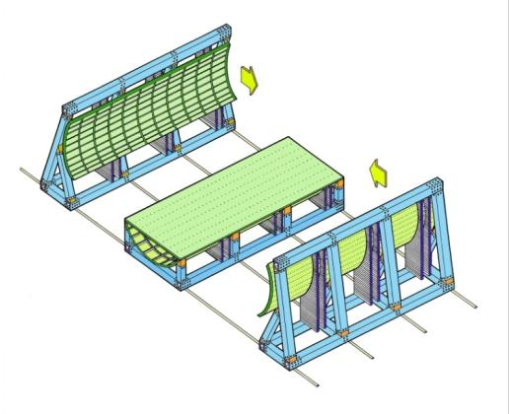
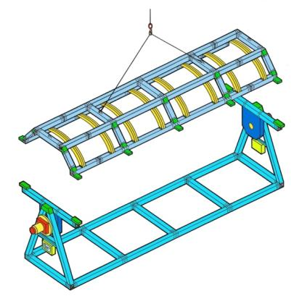
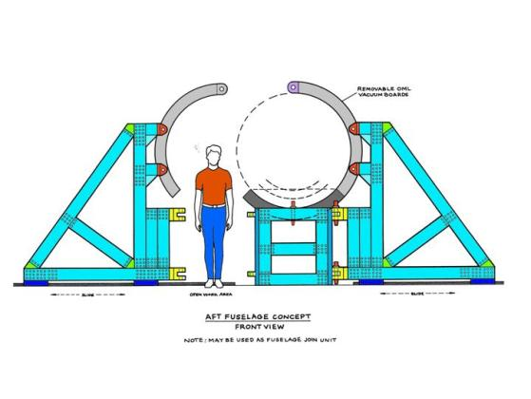
Aft Fuselage Concept
Some materials shown in photos are not sold by C2 Gauge & Fixture

Slide 22
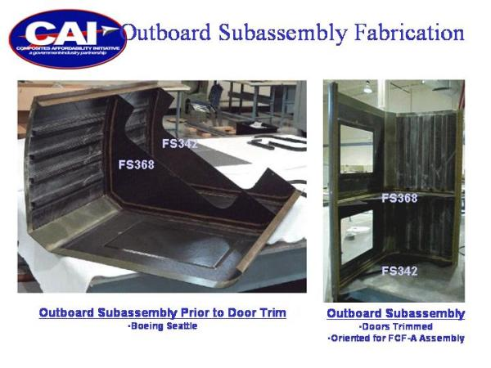
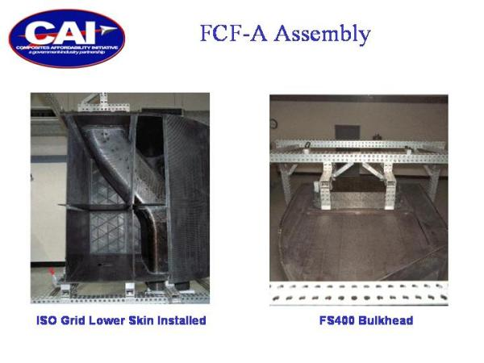

Slide 23
Process Overview
The process entails, but is not limited to, 20 elements that may affect meeting customer specifications, these are:
1. | Management Responsibility | 11. | Control of Inspection
2. | Quality System Requirement | 12. | Inspection & Test Status
3. | Contract Review | 13. | Control on Non-Conforming Product
4. | Design Review | 14. | Corrective and Preventative Action
5. | Document Control | 15. | Handling, Storage, Package, Preservation and Delivery
6. | Purchasing | 16. | Control of Record Quality
7. | Customer Supplied Product | 17. | Internal Quality Audits
8. | Product Identification Traceability | 18. | Training
9. | Process Control | 19. | Servicing
10. | Inspection & Testing | 20. | Statistical Techniques

Slide 24
Benefits of the American Modular Tooling System
Manufacturing and Engineering |  |  | Manufacturing and Assembly
❍ Facility Usage | 48% Less |  | ❍ Assembly Labor | 70% Less
❍ Lead Time | 60% Less |  | ❍ Through-put Increase | 45% More
❍ Tooling Costs | 44% Less |  | ❍ Accuracy of Assemblies | 50% Greater
❍ Tooling Labor | 60% Less |  | ❍ Periodic Inspection | 50% Less
❍ Tooling Design Cost | 50% Less |  | Reconfigurable | Priceless
❍ Equipment Needs | 70% Less |  | Modularity | Priceless
❍ Reusable Material | 70% Reusable |  | ❍ Rapid Engineering Changes | Priceless
Other Benefits
❍ Fewer corrosion problems due to hard coat aluminum |  |  | ❍ Can be used as temporary rate tool
❍ Lower shipping costs due to lighter weight |  |  | ❍ Less space required for storage
❍ Faster setup at customer facility |  |  | ❍ Minimal maintenance requirements
❍ Good ROI on leasing tool (70% reusable) |  |  | ❍ Environmentally correct

Slide 25
Material Properties of AMT Components
AMT “Professional Grade” Extruded Profiles and Locators |  | AMT “Commercial Grade” Extruded Profiles and Locators |  | AMT Locator and connection Elements
❍ 7075-T6, Temper 6 |  | ❍ 6061-T6, Temper 6 |  | ❍ 2024-T6
❍ KSI Tensile: 78,000 PSI |  | ❍ KSI Tensile: 47,000 PSI |  | ❍ KSI Tensile: 69,000 PSI
❍ KSI Yield: 68,000 PSI |  | ❍ KSI Yield: 40,000 PSI |  | ❍ KSI Yield: 57,000 PSI
❍ Hard Coat Anodized |  | ❍ Hard Coat Anodized |  | ❍ Hard Coat Anodized
❍ Elongation Factor: 6% |  | ❍ Elongation Factor: 8% |  | ❍ Elongation Factor: 10%
AMT “Special Duty” Extruded Profiles |  | AMT “Special Duty” Cast Products
❍ 6082-T6, Temper 6, Special Blend |  | ❍ 319, 0-T5 Sand Cast
❍ KSI Tensile: 45,000 PSI |  | ❍ KSI Tensile: 30,000 PSI
❍ KSI Yield: 30,000 PSI |  | ❍ KSI Yield: 26,000 PSI
❍ Hard Coat Anodized |  | ❍ Hard Coat Anodized
❍ Elongation Factor: 4.5 - 5.5% |  | ❍ Elongation Factor: 1.5%

Slide 26
Press
American Modular Tooling:
​
Modular Tooling Keeps on Truckin', Quality Magazine, September 2021
Modular Fixturing for Clay Model Making Today, Quality Magazine, March 2020
Fixturing 101: The Sky's the Limit, Quality Magazine, July 2019
Modular Fixturing: How It Works, Quality Magazine, January 2018
Modular Tooling Evolves, Quality Magazine, April 2017
Quality 101: Modular Fixturing Takes Off, Quality Magazine, March 2009
Case Studies: A Modular Fix, Quality Magazine, June 2008
Simplicity Key to CMM Fixturing, Quality Magazine, February 2004
American Modular Tooling Full Line Catalog
American Modular Tooling Studio Tools Catalog
Styli and CMM Accessories:
​
Five Steps to Selecting Styli, Quality Magazine, February 2009
Probes Push CMMs Forward, Quality Magazine, May 2003
CMM Styli and Accessories Full Line Catalog
Measurements and Standards:
​
What is Uncertainty? In Metrology, It's Truly a Deep, Sensitive Subject, Quality Magazine, May 2022
Measurement and Standards Full Line Catalog

Slide 27
If you would like more information about American Modular Tooling or to schedule a demonstration please visit our web sites or contact us with any method below and we’ll be happy to assist you.
American Modular Tooling
Paul W. Marino Gages, Inc. PWM Measurement & Standards, LLC 1 SE Ocean Blvd. Stuart, FL 34994 USA Phone: 313.300.0134
Email: pwminc@pmargage.com Web: pmargage.com / shoppwm.com Linda Goodwin-Marino, President Email: lmarino@pmargage.com
Technical Sales & Consultation Woman Owned Small Business
AmericanModularTooling.com
The contents of this presentation are confidential and are copyrighted by Paul W. Marino Gages, Inc. AMT and American Modular Tooling are registered trade names of Paul W. Marino Gages, Inc., use by permission only.

